Slide 1

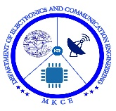

RAILWAY COMPARTMENT SAFETY SYSTEM USING RF
GUIDED BY
TEAM MEMBERS
CIBI C (20BEC4027) DR.G.SHANMUGAVADIVEL M.E., Ph.D
DHARUN M (20BEC4034) (ASSOCIATE PROFESSOR)
RAGUNATH K (20BEC4310)

Slide 2

OBJECTIVES
Passenger Safety: The system aims to ensure the safety of passengers by continuously monitoring the compartments for various hazards such as fire, smoke, or sudden temperature changes.
Compliance with Safety Standards: The objective of the RF safety system is to comply with established safety standards and regulations for railway travel.
Integration with Central Control Systems: The RF safety system can be integrated with the central control systems of the railway network.
Remote Monitoring and Control: The system allows for remote monitoring and control of compartment safety conditions.

Slide 3
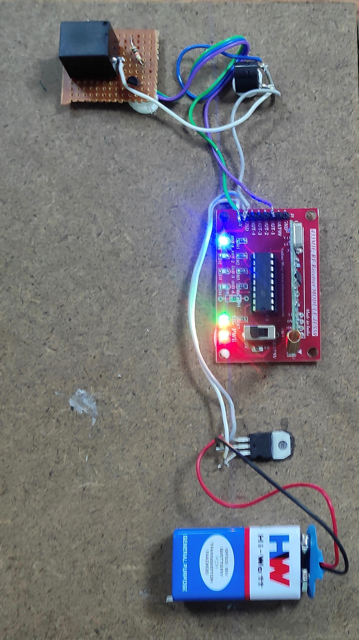
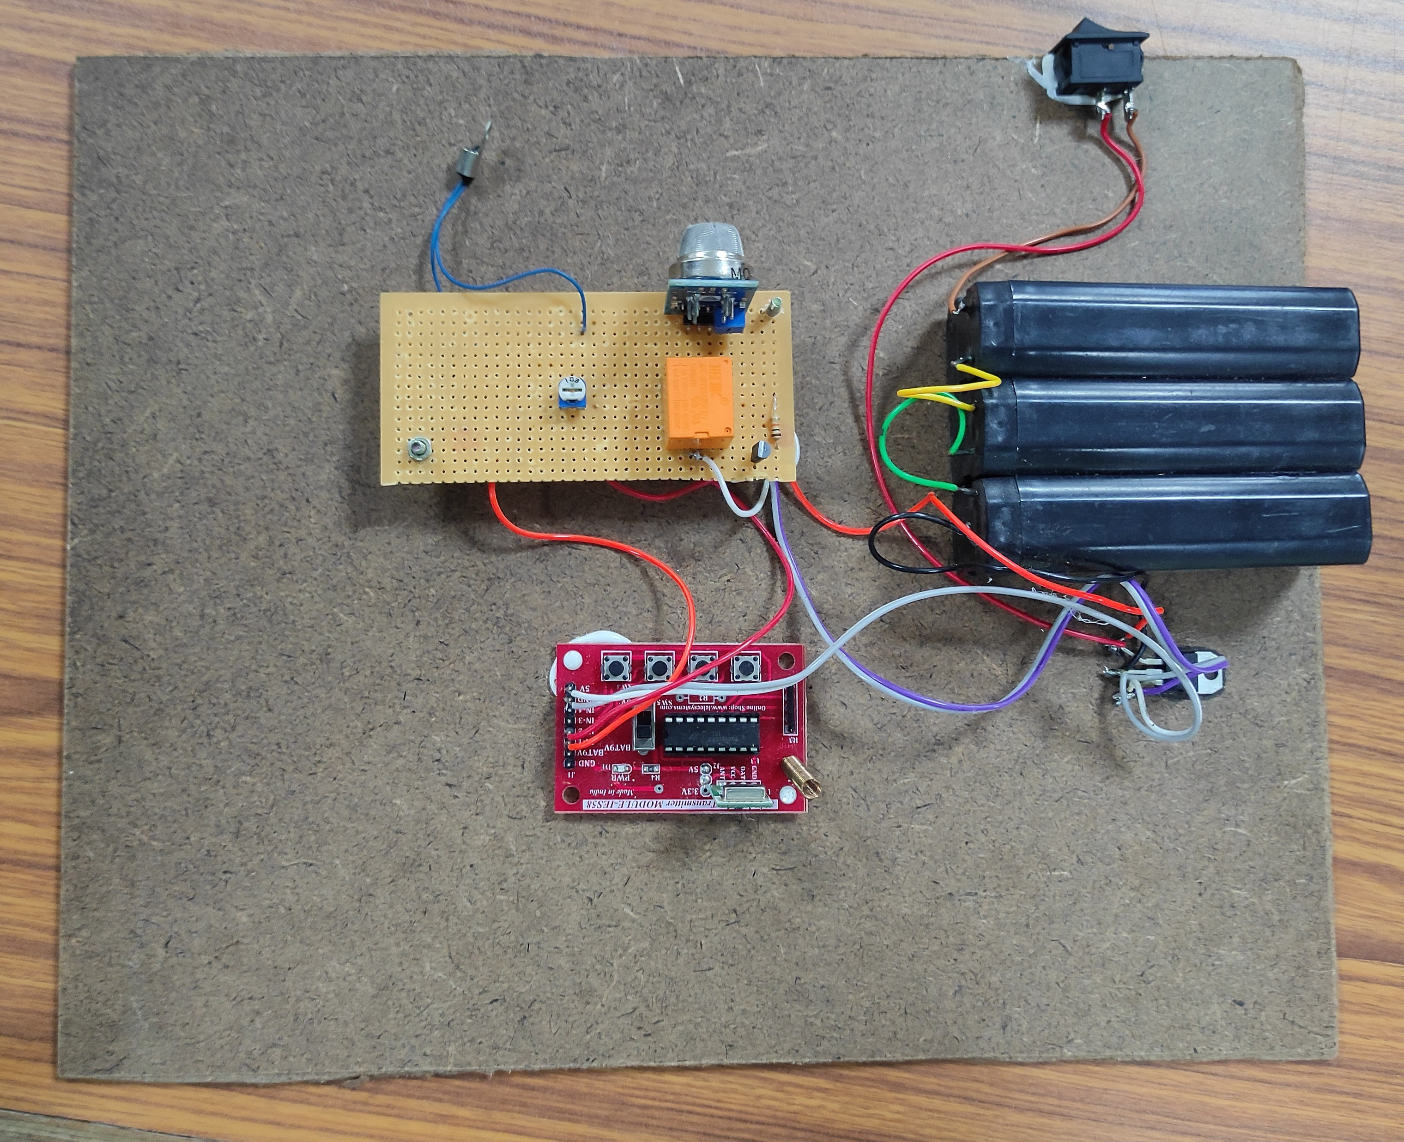
PROJECT MODEL
TRANSMITTER
RECEIVER

Slide 4

ADVANTAGES
Enhanced safety: RF technology enables real-time monitoring of compartments, providing improved safety for passengers and their belongings.
Quick response: RF-based systems can instantly transmit alerts to the train crew and railway control centers when any abnormal or hazardous event is detected.
Scalability and flexibility: RF-based safety systems can be easily implemented and scaled up across different compartments or train fleets.
Cost-effective: RF technology is relatively cost-effective compared to other sophisticated safety systems.

Slide 5

APPLICATION
Communication: The RF system enables wireless communication between different components within the train, such as passenger compartments, the driver's cabin, and the control center.
Passenger Tracking: RF tags or devices can be provided to passengers, which transmit signals to track their location within the train.
Emergency Alerts: In the event of a safety or security threat, passengers can trigger an emergency alert using RF devices.
Surveillance: RF-based cameras or sensors can be installed in compartments to monitor activities and detect suspicious behavior.

